Slide 1
Physical Activity Intervention
No
Yes
Experimental Units
No
1
2
3
4
5
6
7
8
9
10
11
12
13
14
15
16
17
18
19
20
21
22
23
24
25
26
27
28
29
30
31
32
33
34
35
36
37
38
39
40
Nutrition Intervention
41
42
43
44
45
46
47
48
49
50
51
52
53
54
55
56
57
58
59
60
Yes

Slide 2
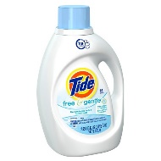
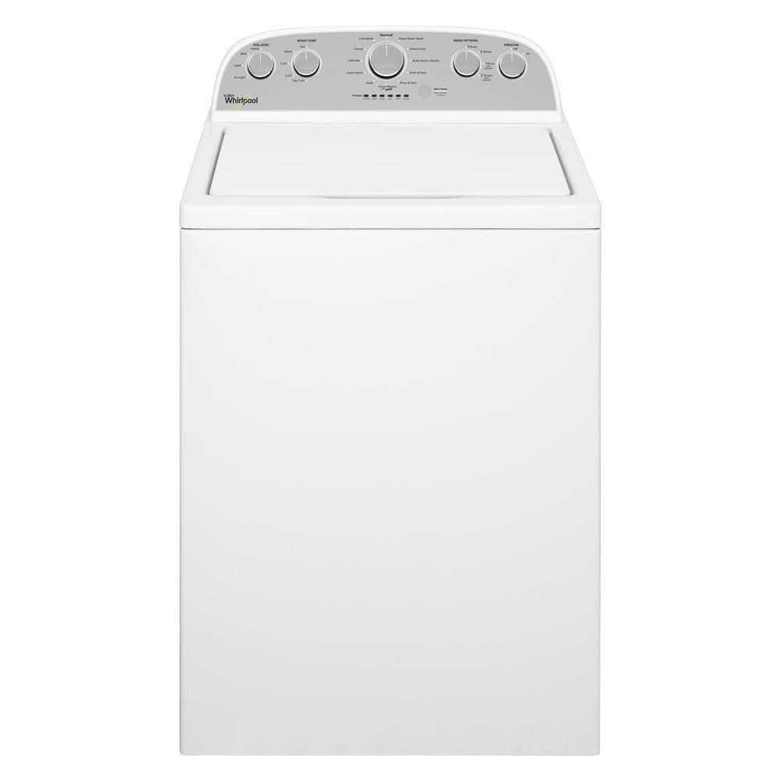
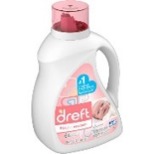
Detergent Example
Detergent #1
Detergent #2
Experimental Units
1
3
5
9
10
7
2
4
6
8

Slide 3
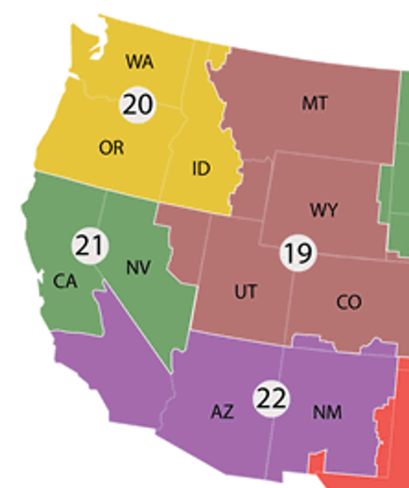
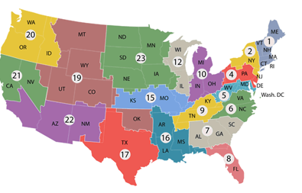

Slide 4
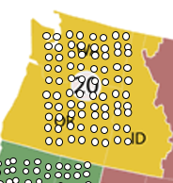
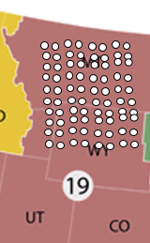
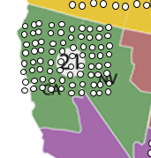
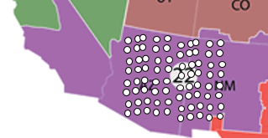
Randomly assign in Region 20
Randomly assign in Region 19
Randomly assign in Region 21
Randomly assign in Region 22

Slide 5
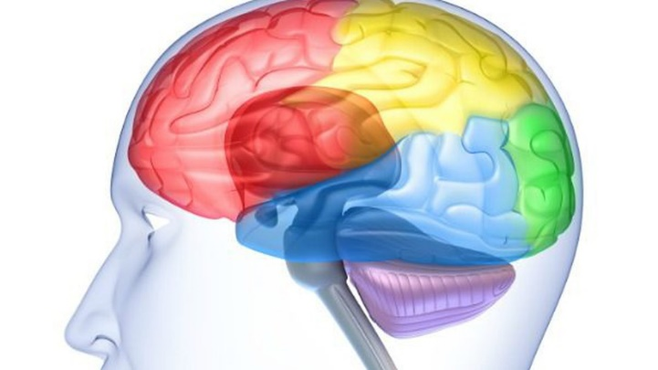
Memory Example
Treatment #1
Treatment #2
Experimental Units
7 : Age 43
2 : Age 28
10 : Age 58
3 : Age 32
6 : Age 35
8 : Age 50
5 : Age 32
1 : Age 23
4 : Age 25
9: Age 60

